Slide 1

Supermarket Product Classification Using Deep Learning (CNN)
Course: CS-417
Project: 10
Team Members:
Amr Yasser – 2227364
Mohamed Anwar – 2227277
Seif Mohamed – 2227567
Ahmed Mohamed – 2227351
Adham Ehab – 2227109

Slide 2

The Challenge: Automating Supermarket Product Classification
Manual product classification in supermarkets presents significant hurdles, from operational inefficiencies to human error. Current barcode-based systems, while functional, often lack the flexibility required for dynamic retail environments.
Current Limitations
High labour costs and time consumption.
Prone to human error in data entry and stocking.
Inefficient inventory management processes.
Limited flexibility for dynamic product changes.
Our project addresses these issues by leveraging computer vision to introduce an automated, intelligent classification system.

Slide 3




Project Vision: Smart Product Classification with CNNs
Our solution harnesses the power of Convolutional Neural Networks (CNNs) to classify supermarket products directly from images, overcoming the limitations of traditional methods.
Computer Vision Integration
Utilising advanced image recognition to identify products.
Four Key Categories
Products classified into Beverage, Canned/Preserved, Pantry & Dry Goods, and Snack/Confectionery.
Deep Learning Core
A robust CNN model at the heart of the classification engine.

Slide 4

Empowering Retail: Target Users & Applications
This deep learning solution offers substantial benefits across various retail segments, enhancing efficiency and customer experience.
Retail Companies Streamlining inventory and reducing manual effort.
Self-Checkout Systems Accelerating transactions and reducing queues.
Smart Shopping Carts Real-time product identification and personalised shopping.
Inventory Management Automated stock level monitoring and reordering.
Retail Analytics Providing insights into consumer behaviour and shelf performance.
Imagine a future where every product is recognised instantly.

Slide 5
Dataset and Data Augmentation
Dataset Overview
Dataset Name: Freiburg Groceries Dataset
Source: University of Freiburg
Total Images: Approximately 5,000 images
Original Classes: 25 grocery product categories
Final Classes Used: 4 main categories (Beverage, Canned/Preserved, Pantry & Dry Goods, Snack/Confectionery)
Image Type: RGB images from real supermarket environments
Image Size: Resized to 224 × 224 pixels for MobileNetV2
Class consolidation applied to reduce imbalance, simplify classification, and improve generalization.
Data Splitting Strategy
Training Set: 70%
Validation Set: 15%
Test Set: 15%
Training data learns patterns, validation monitors overfitting, test data kept unseen for fair evaluation.
Data Augmentation Techniques (applied to training set only)
Rotation: Simulates different camera angles
Horizontal Flip: Handles left/right orientation variations
Zoom: Mimics different distances from products
Brightness Adjustment: Improves robustness to lighting changes
Why Data Augmentation Matters
Increases effective dataset size
Reduces overfitting
Improves model robustness in real-world scenarios
Helps generalization to unseen products

Slide 6


Model Architecture: MobileNetV2-Based CNN
Our solution leverages the power of transfer learning with the MobileNetV2 architecture, a highly efficient convolutional neural network pre-trained on the vast ImageNet dataset. This approach allows us to capitalize on pre-existing knowledge of image features while adapting the model to our specific product classification task.
Frozen MobileNetV2 Base
Custom Classification Head
Optimized for Efficiency
The core MobileNetV2 model acts as a powerful feature extractor, retaining its pre-trained weights to capture rich, hierarchical features from product images.
We've appended a custom classification head designed specifically for our four product categories. This head consists of Global Average Pooling, followed by Dense layers, Dropout for regularization, and a Softmax activation layer.
This architecture provides high classification accuracy while ensuring computational efficiency, making it suitable for potential real-world deployment in retail environments.
MobileNetV2
Global Avg Pool
Dense + Dropout
Softmax (4)
This streamlined architecture allows us to achieve robust product classification with significantly fewer computational resources and training data compared to building a model from scratch.

Slide 7
Model Training Phase
Data Split
Training: 70% | Validation: 15% | Test: 15%
Validation set monitors performance during training and prevents overfitting
Training Strategy
Two-stage approach:
Initial Training
Fine-Tuning
MobileNetV2 base frozen, only custom classification layers trained
Last MobileNetV2 layers unfrozen, training with very low learning rate
Optimizer and Loss Function
Optimizer: Adam (adaptive learning rate)
Loss Function: Categorical Cross-Entropy (multi-class classification)
Regularization and Callbacks
Data Augmentation for improved generalization
Early Stopping when validation loss plateaus
Model Checkpoint to save best-performing model
Outcome
Training converged smoothly
Validation accuracy improved steadily
Best model saved for evaluation and deployment

Slide 8
Codebase Structure: An Overview
Our project is organised into distinct modules, each responsible for a critical component of the deep learning pipeline, from data handling to model deployment.
dataset.py
model.py
train.py
Handles data loading, category mapping, and generator creation for efficient batch processing.
Defines the MobileNetV2 architecture, including the frozen base and custom classification head.
Manages the training and fine-tuning pipeline, integrating optimisers, loss functions, and callbacks.
evaluate.py
app.py
Calculates key metrics such as accuracy, loss, and generates comprehensive classification reports.
Hosts the Streamlit user interface, allowing for interactive demonstrations and real-time predictions.

Slide 9
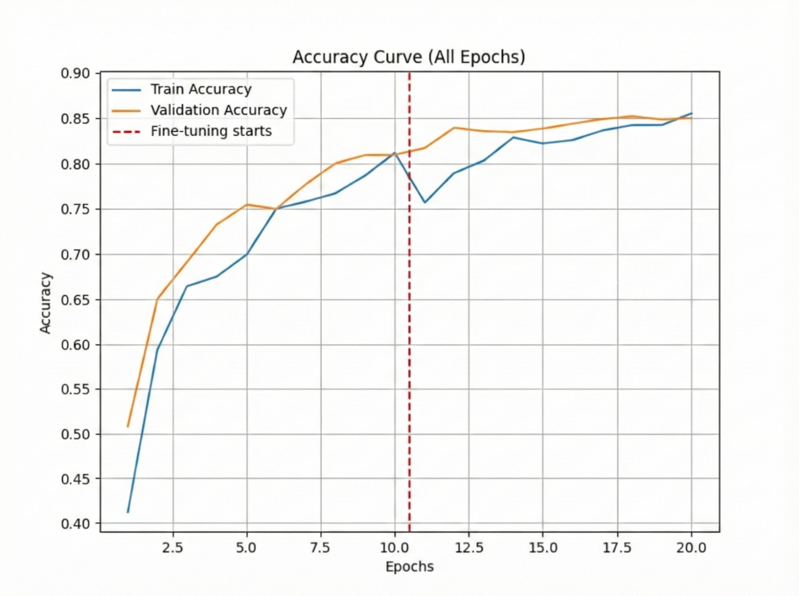
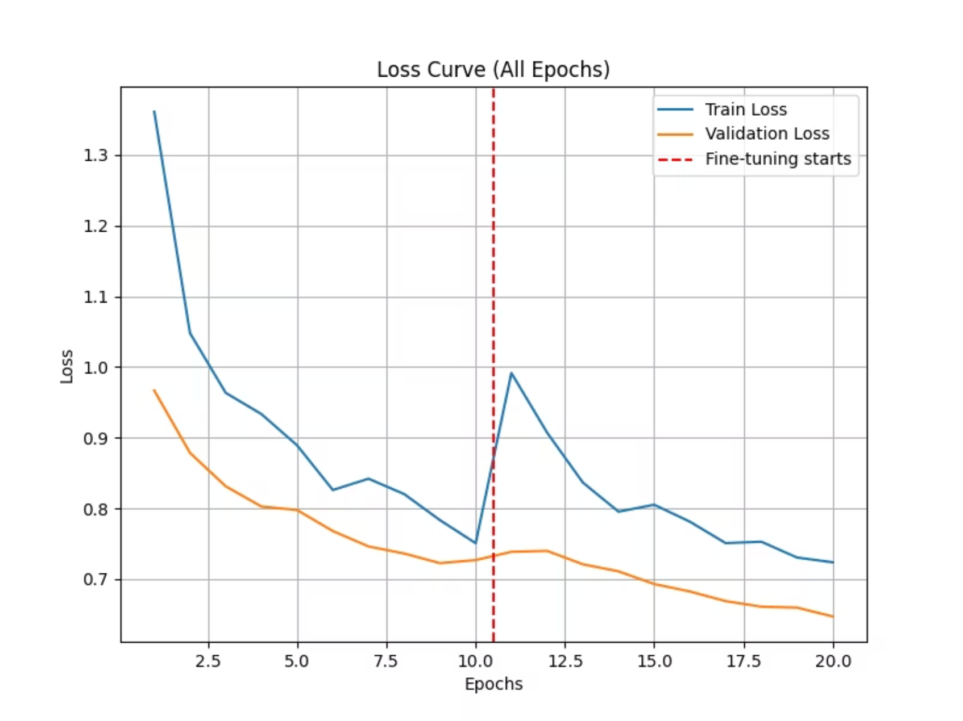
Training Performance: Accuracy and Loss Curves
These curves illustrate the model's training and validation performance across epochs, providing insights into convergence and potential overfitting.

Slide 10
